Slide 1
Statistics
Regression, correlation
and hypothesis testing
Twitter: @Owen134866
www.mathsfreeresourcelibrary.com

Slide 2
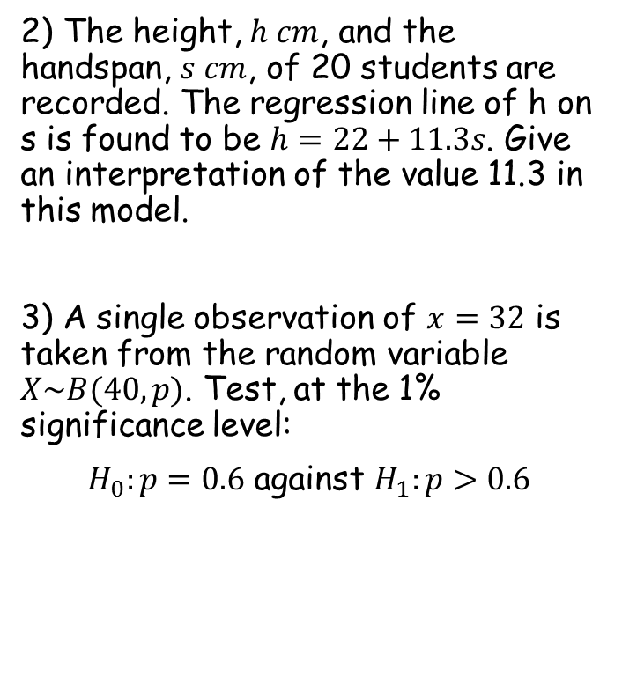

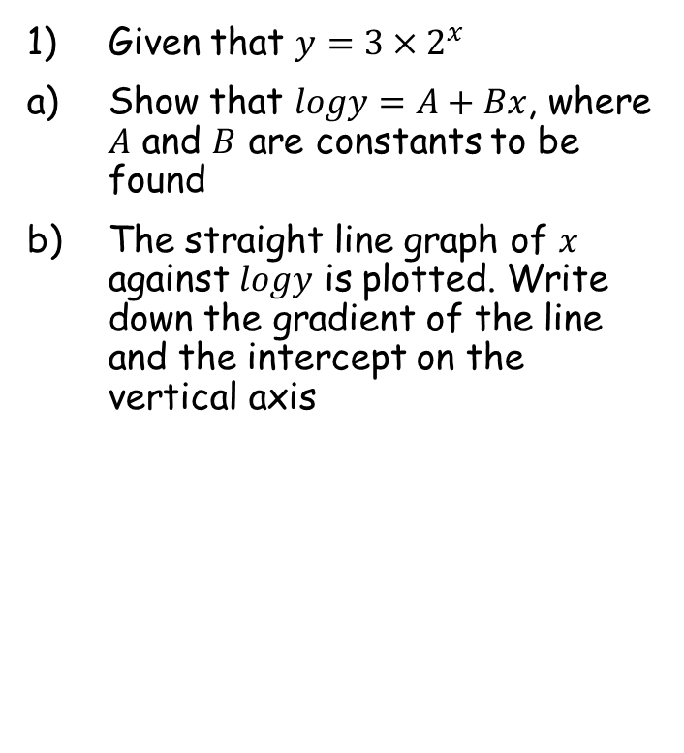

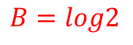
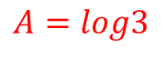

Prior knowledge check
Given that $y=3×2^{x}$
Show that $logy=A+Bx$, where $A$ and $B$ are constants to be found
The straight line graph of $x$ against $logy$ is plotted. Write down the gradient of the line and the intercept on the vertical axis
2) The height, $h cm$, and the handspan, $s cm$, of 20 students are recorded. The regression line of h on s is found to be $h=22+11.3s$. Give an interpretation of the value 11.3 in this model.
3) A single observation of $x=32$ is taken from the random variable $X\sim B(40,p)$. Test, at the 1% significance level:
$H_{0}:p=0.6$ against $H_{1}:p>0.6$
$$A=log3$$
$$B=log2$$
For every 1cm increase in handspan, the person’s height increases by 11.3cm
Gradient = $log2$
y-intercept = $log3$
$$P\left(X≥32\right)=0.0061$$
Less than 0.01 so $H_{0}$ rejected

Slide 3
Teachings for
Exercise 1A

Slide 4
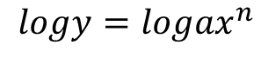
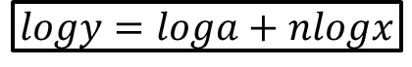
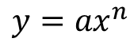
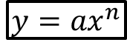
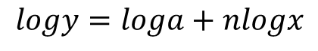
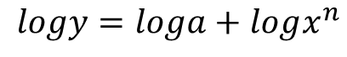
Regression, correlation and hypothesis testing
$$y={ax}^{n}$$
$$logy=loga+nlogx$$
You need to be able to use logarithms and coding to analyse trends in non-linear data
You have seen this in the Pure Year 1 course, chapter 14
Let’s have a reminder of how the relationships should be written…
$$y={ax}^{n}$$
Take logs of both sides
$$logy=log{ax}^{n}$$
Separate using the addition law
$$logy=loga+logx^{n}$$
Use the power law
$$logy=loga+nlogx$$
1A

Slide 5
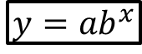
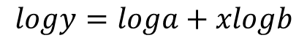
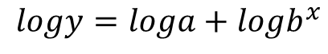
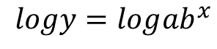
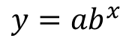

Regression, correlation and hypothesis testing
$$y={ax}^{n}$$
$$logy=loga+nlogx$$
$$y={ab}^{x}$$
$$logy=loga+xlogb$$
Variable raised to a power
Variable is the power
You need to be able to use logarithms and coding to analyse trends in non-linear data
You have seen this in the Pure Year 1 course, chapter 14
Let’s have a reminder of how the relationships should be written…
$$y={ab}^{x}$$
Take logs of both sides
$$logy=log{ab}^{x}$$
Separate using the addition law
$$logy=loga+logb^{x}$$
Use the power law
$$logy=loga+xlogb$$
1A

Slide 6
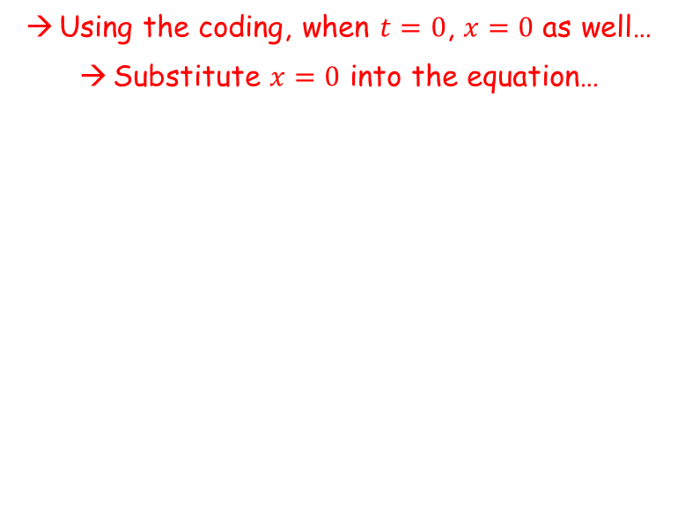
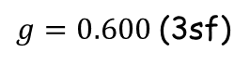
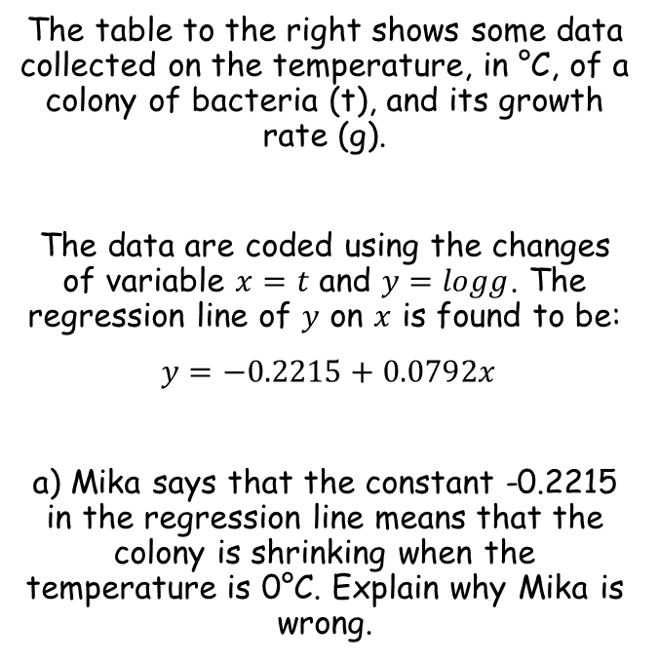
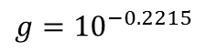

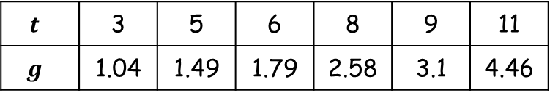
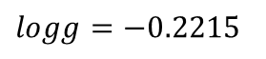

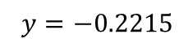
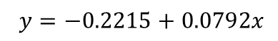
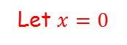
Regression, correlation and hypothesis testing
$$y={ax}^{n}$$
$$logy=loga+nlogx$$
$$y={ab}^{x}$$
$$logy=loga+xlogb$$
You need to be able to use logarithms and coding to analyse trends in non-linear data
$$t$$ | 3 | 5 | 6 | 8 | 9 | 11
$$g$$ | 1.04 | 1.49 | 1.79 | 2.58 | 3.1 | 4.46
The table to the right shows some data collected on the temperature, in °C, of a colony of bacteria (t), and its growth rate (g).
The data are coded using the changes of variable $x=t$ and $y=logg$. The regression line of $y$ on $x$ is found to be:
$y=−0.2215+0.0792x$
a) Mika says that the constant -0.2215 in the regression line means that the colony is shrinking when the temperature is 0°C. Explain why Mika is wrong.
Using the coding, when $t=0$, $x=0$ as well…
Substitute $x=0$ into the equation…
$y=−0.2215+0.0792x$
Let $x=0$
$y=−0.2215$
Remember that $y=logg$
$$logg=−0.2215$$
Inverse log (remember that log on its own means $\log_{10}$)
$$g={10}^{−0.2215}$$
Calculate
$g=0.600$(3sf)
So the growth rate is positive, the colony is not shrinking
1A

Slide 7
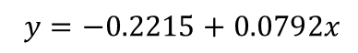
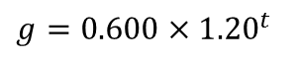
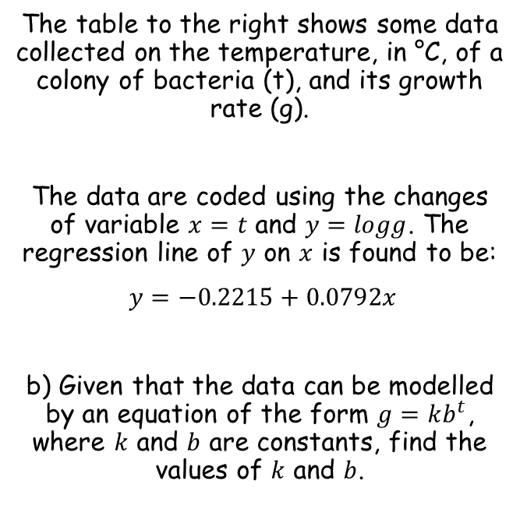
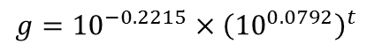
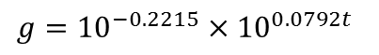
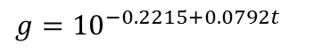
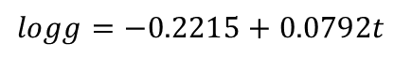
Regression, correlation and hypothesis testing
$$y={ax}^{n}$$
$$logy=loga+nlogx$$
$$y={ab}^{x}$$
$$logy=loga+xlogb$$
You need to be able to use logarithms and coding to analyse trends in non-linear data
$$t$$ | 3 | 5 | 6 | 8 | 9 | 11
$$g$$ | 1.04 | 1.49 | 1.79 | 2.58 | 3.1 | 4.46
The table to the right shows some data collected on the temperature, in °C, of a colony of bacteria (t), and its growth rate (g).
The data are coded using the changes of variable $x=t$ and $y=logg$. The regression line of $y$ on $x$ is found to be:
$y=−0.2215+0.0792x$
b) Given that the data can be modelled by an equation of the form $g=kb^{t}$, where $k$ and $b$ are constants, find the values of $k$ and $b$.
You can use the coding again to get the equation in the required form – substitute both ‘codes’ into the equation you are given…
$y=−0.2215+0.0792x$
Sub both the coded expressions in…
$$logg=−0.2215+0.0792t$$
Inverse logarithm
$$g={10}^{−0.2215+0.0792t }$$
Write as two terms multiplied
$$g={10}^{−0.2215}×{10}^{0.0792t}$$
Rewrite second term
$$g={10}^{−0.2215}×{\left({10}^{0.0792}\right)}^{t}$$
Calculate the powers of 10
$$g=0.600×{1.20}^{t}$$
So therefore $k=0.600$ and $b=1.20$ (both to 3sf)
1A

Slide 8
Teachings for
Exercise 1B

Slide 9
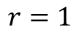
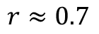
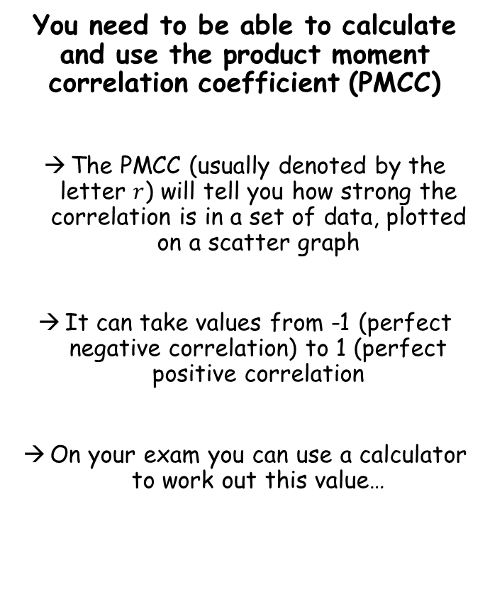
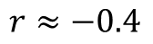
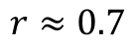
Regression, correlation and hypothesis testing
You need to be able to calculate and use the product moment correlation coefficient (PMCC)
The PMCC (usually denoted by the letter $r$) will tell you how strong the correlation is in a set of data, plotted on a scatter graph
It can take values from -1 (perfect negative correlation) to 1 (perfect positive correlation
On your exam you can use a calculator to work out this value…
$$r=1$$
$$r≈0.7$$
→ Remember the number is not the gradient, just how well the data is correlated…
$$r≈0.7$$
$$r≈−0.4$$
1B

Slide 10
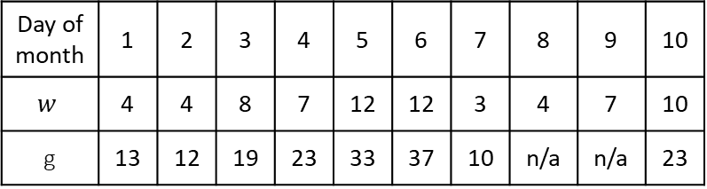
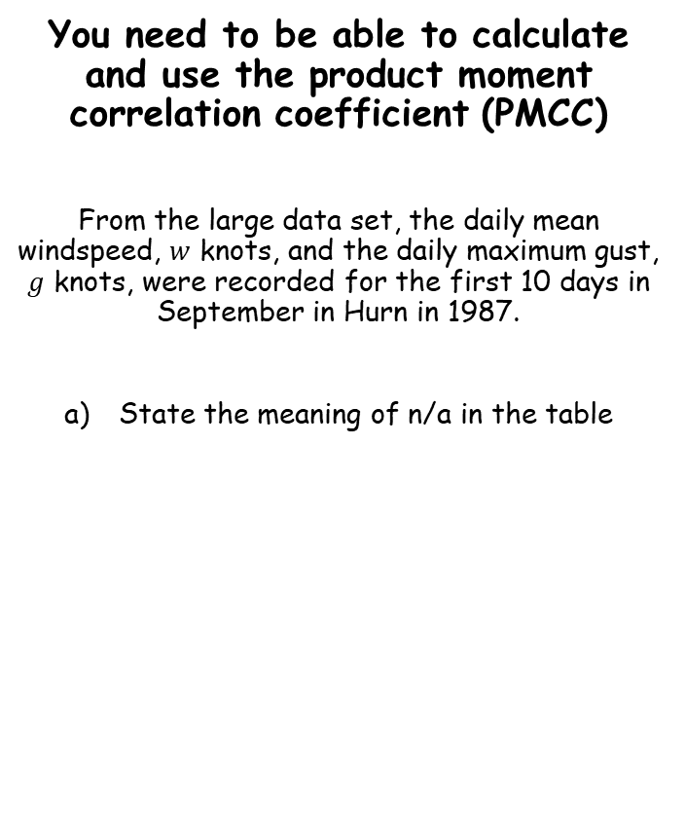
Regression, correlation and hypothesis testing
You need to be able to calculate and use the product moment correlation coefficient (PMCC)
From the large data set, the daily mean windspeed, $w$ knots, and the daily maximum gust, $g$ knots, were recorded for the first 10 days in September in Hurn in 1987.
State the meaning of n/a in the table
Day of month | 1 | 2 | 3 | 4 | 5 | 6 | 7 | 8 | 9 | 10
$$w$$ | 4 | 4 | 8 | 7 | 12 | 12 | 3 | 4 | 7 | 10
g | 13 | 12 | 19 | 23 | 33 | 37 | 10 | n/a | n/a | 23
→ The n/a in the table indicates that no data is available on those days
1B

Slide 11


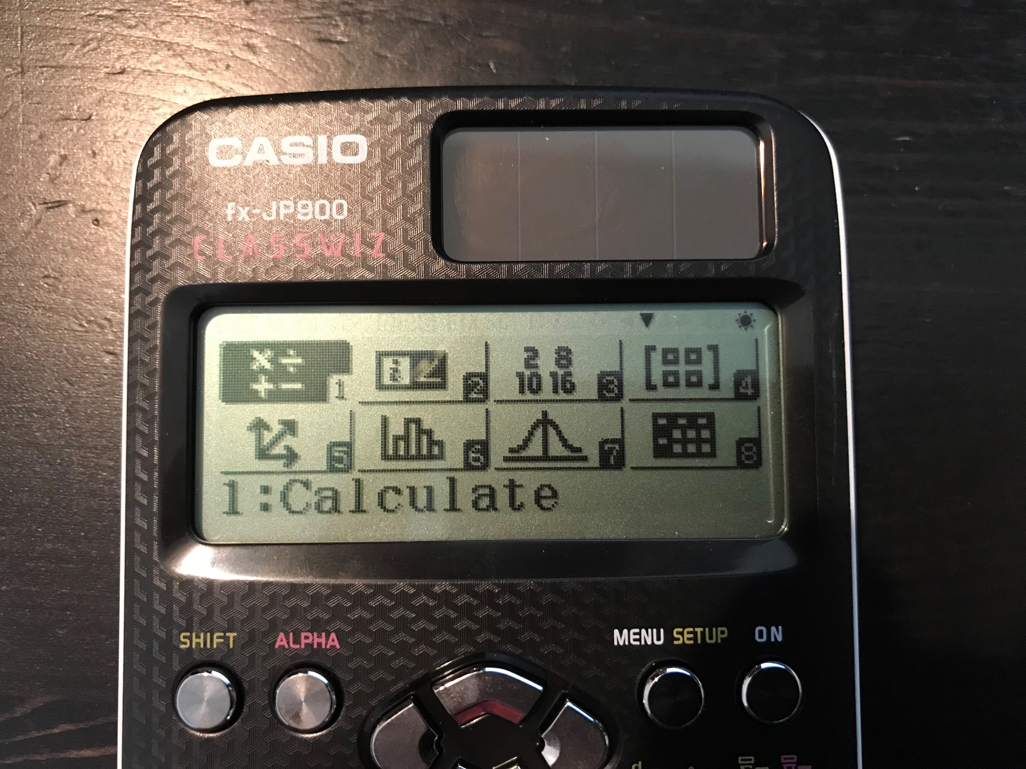
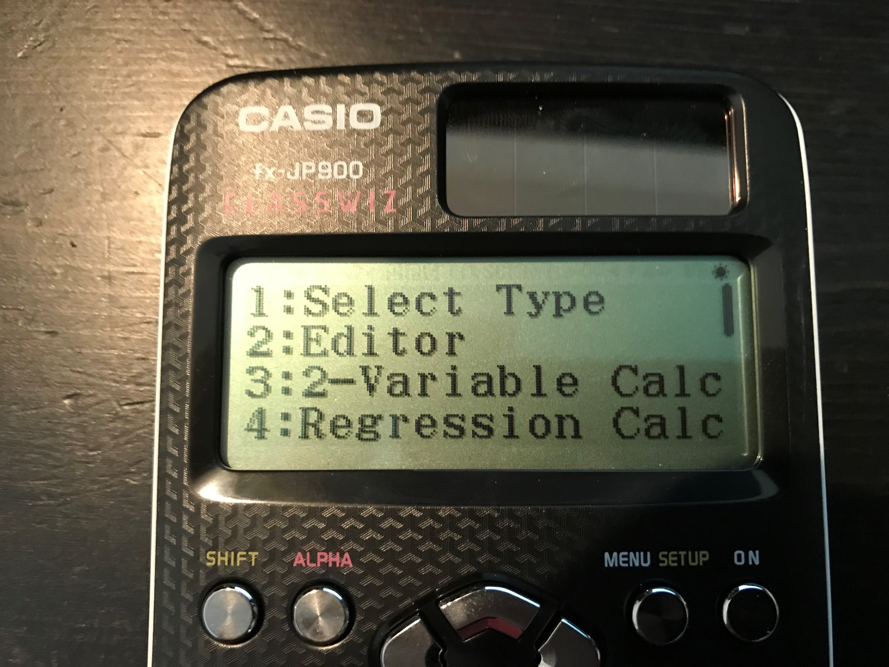
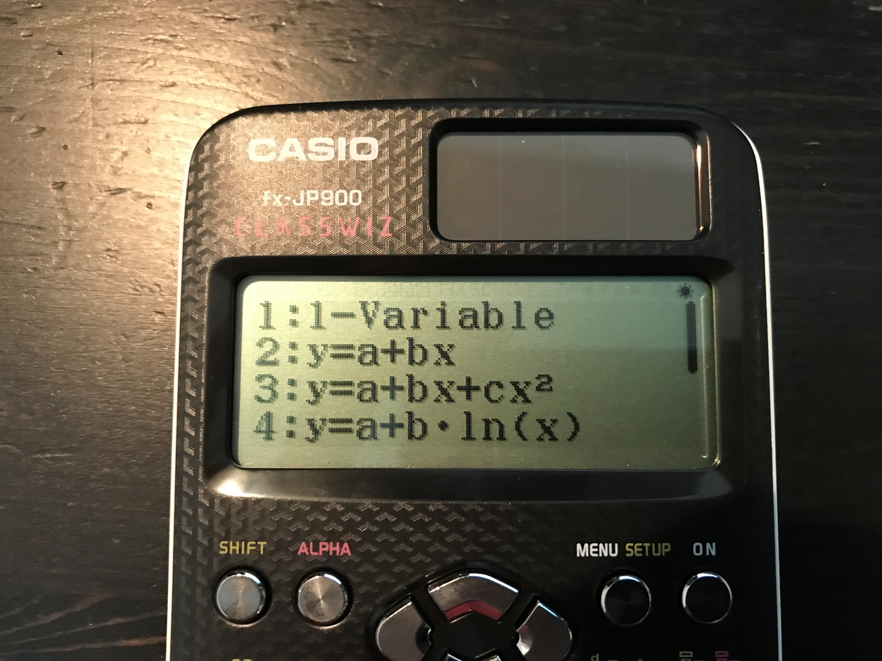
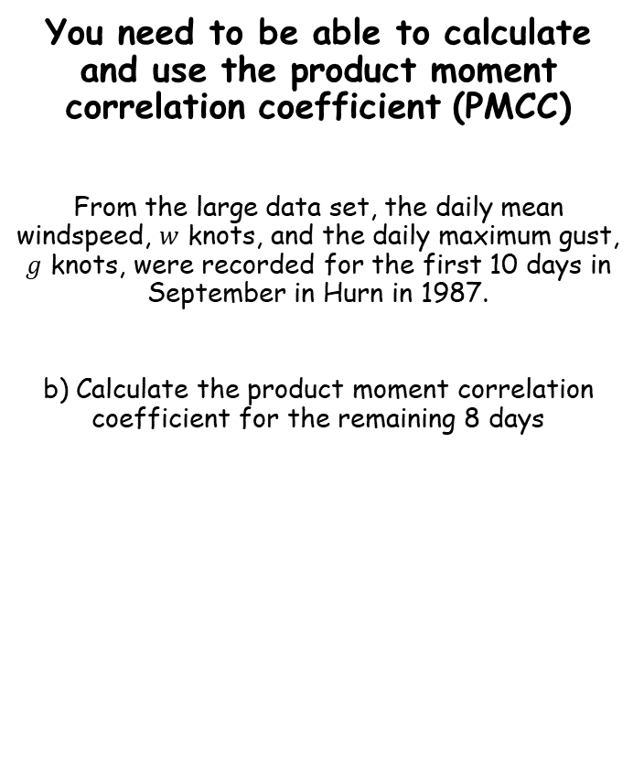
Regression, correlation and hypothesis testing
You need to be able to calculate and use the product moment correlation coefficient (PMCC)
From the large data set, the daily mean windspeed, $w$ knots, and the daily maximum gust, $g$ knots, were recorded for the first 10 days in September in Hurn in 1987.
b) Calculate the product moment correlation coefficient for the remaining 8 days
Day of month | 1 | 2 | 3 | 4 | 5 | 6 | 7 | 8 | 9 | 10
$$w$$ | 4 | 4 | 8 | 7 | 12 | 12 | 3 | 4 | 7 | 10
g | 13 | 12 | 19 | 23 | 33 | 37 | 10 | n/a | n/a | 23
→ Now press 2, since we want a linear regression
→ Now enter the data (remember to ignore the n/a values from this question…)
→ On your casio classwiz, press menu
→ Now press the OPTN button
→ Now press 6
→ Now press 4
1B

Slide 12


Regression, correlation and hypothesis testing
You need to be able to calculate and use the product moment correlation coefficient (PMCC)
From the large data set, the daily mean windspeed, $w$ knots, and the daily maximum gust, $g$ knots, were recorded for the first 10 days in September in Hurn in 1987.
b) Calculate the product moment correlation coefficient for the remaining 8 days
Day of month | 1 | 2 | 3 | 4 | 5 | 6 | 7 | 8 | 9 | 10
$$w$$ | 4 | 4 | 8 | 7 | 12 | 12 | 3 | 4 | 7 | 10
g | 13 | 12 | 19 | 23 | 33 | 37 | 10 | n/a | n/a | 23
→ Now press 4
→ Your screen displays 3 values. The PMCC is $r$, in this case 0.9533 (2dp)
→ The other values help give you the equation of the line of best fit for this data (in the form shown above it). This is not required in this chapter though!
1B

Slide 13
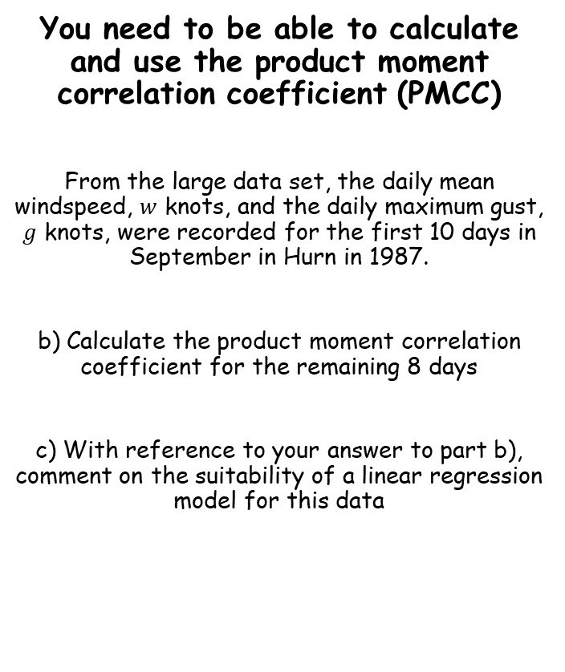
Regression, correlation and hypothesis testing
You need to be able to calculate and use the product moment correlation coefficient (PMCC)
From the large data set, the daily mean windspeed, $w$ knots, and the daily maximum gust, $g$ knots, were recorded for the first 10 days in September in Hurn in 1987.
b) Calculate the product moment correlation coefficient for the remaining 8 days
c) With reference to your answer to part b), comment on the suitability of a linear regression model for this data
Day of month | 1 | 2 | 3 | 4 | 5 | 6 | 7 | 8 | 9 | 10
$$w$$ | 4 | 4 | 8 | 7 | 12 | 12 | 3 | 4 | 7 | 10
g | 13 | 12 | 19 | 23 | 33 | 37 | 10 | n/a | n/a | 23
0.9533
→ Since the value of 0.9533 is close to 1, there is a very strong positive correlation between these data. Hence, a linear regression model is suitable.
1B

Slide 14
Teachings for
Exercise 1C

Slide 15
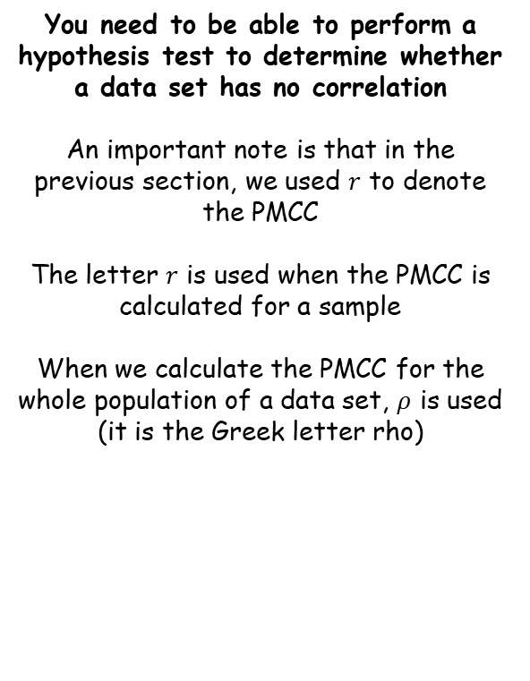
Regression, correlation and hypothesis testing
You need to be able to perform a hypothesis test to determine whether a data set has no correlation
An important note is that in the previous section, we used $r$ to denote the PMCC
The letter $r$ is used when the PMCC is calculated for a sample
When we calculate the PMCC for the whole population of a data set, $ρ$ is used (it is the Greek letter rho)
When testing if the population PMCC, p, is either greater than or below zero, you need to use a one-tailed test
When testing whether it is not equal to 0, you should use a two-tailed test…
1C

Slide 16
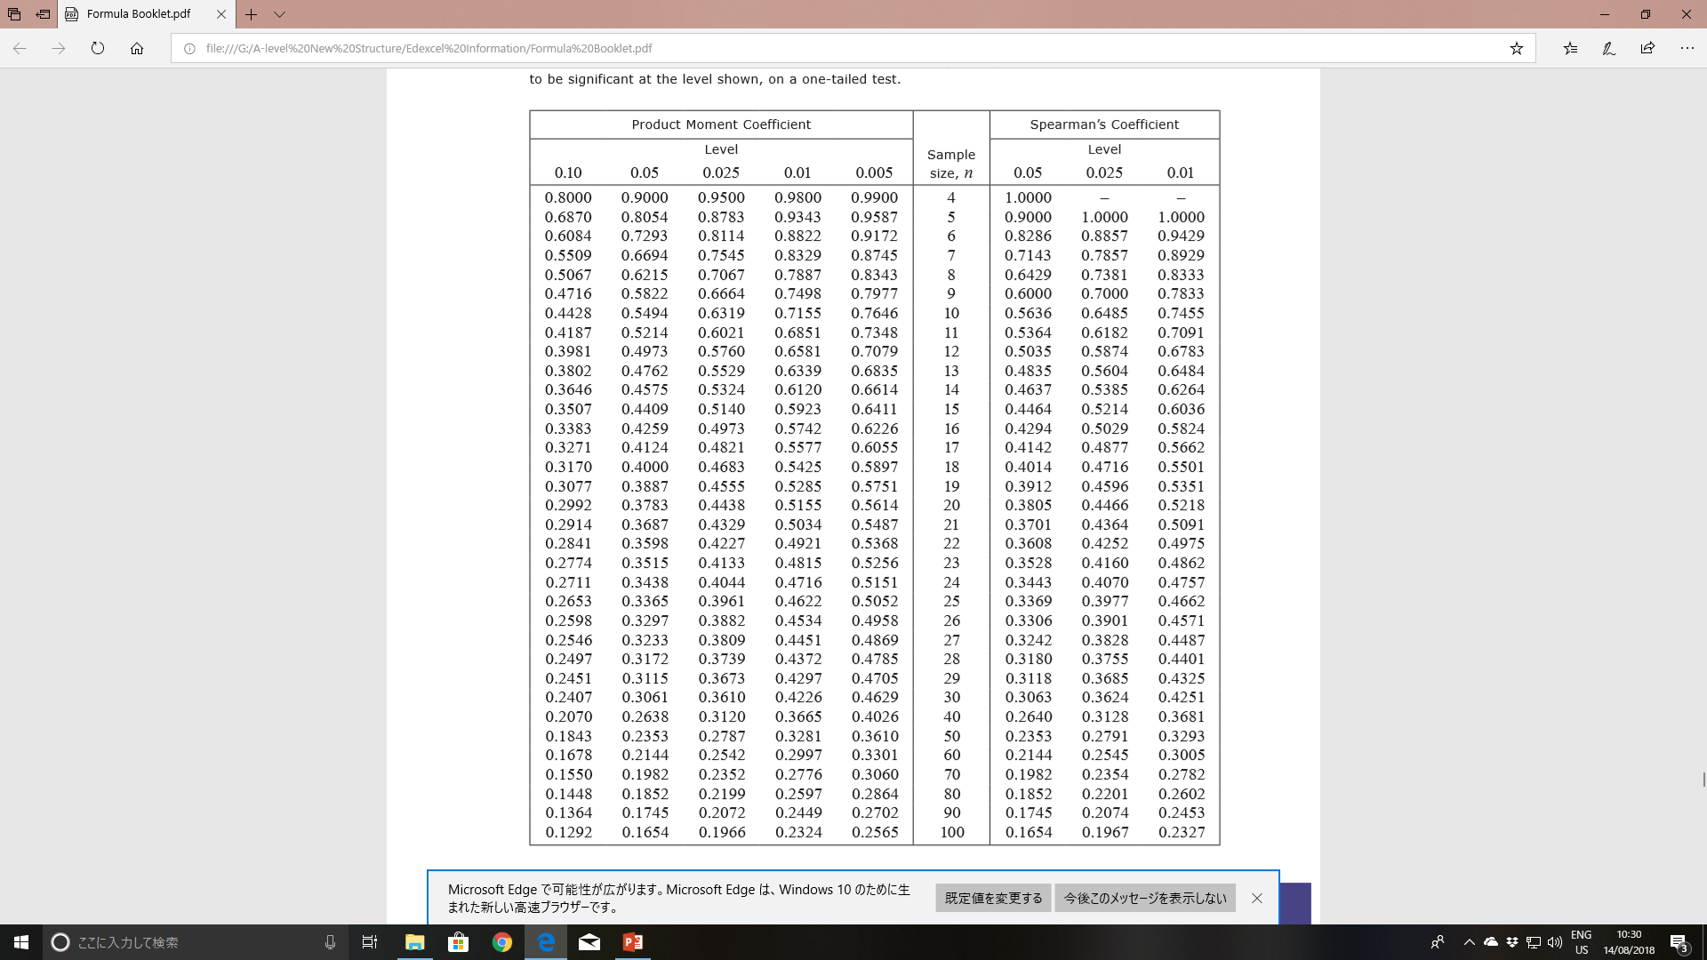
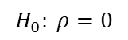
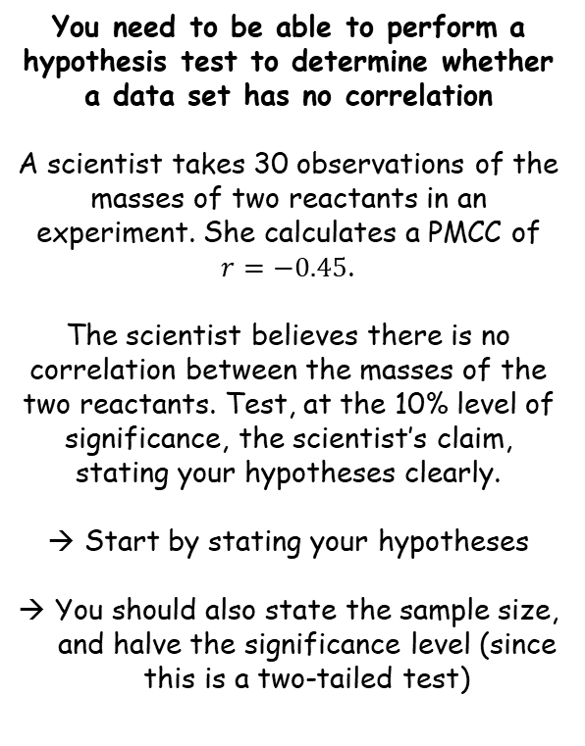
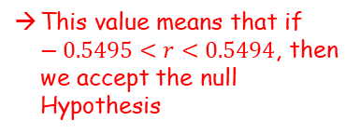
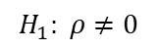
Regression, correlation and hypothesis testing
You need to be able to perform a hypothesis test to determine whether a data set has no correlation
A scientist takes 30 observations of the masses of two reactants in an experiment. She calculates a PMCC of $r=−0.45$.
The scientist believes there is no correlation between the masses of the two reactants. Test, at the 10% level of significance, the scientist’s claim, stating your hypotheses clearly.
Start by stating your hypotheses
You should also state the sample size, and halve the significance level (since this is a two-tailed test)
$$H_{0}: ρ=0$$
$$H_{1}: ρ≠0$$
Sample size = 30
Significance level in each tail: 0.05
Finding the critical region
You will be given a table of data in the formula booklet, for use with the PMCC
If we had a sample size of 10, and were testing with 5% in each tail, the corresponding value in the table is 0.5494
This value means that if $−0.5495<r<0.5494$, then we accept the null Hypothesis
1C

Slide 17
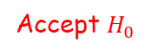











Regression, correlation and hypothesis testing
You need to be able to perform a hypothesis test to determine whether a data set has no correlation
$H_{0}: ρ=0$ (ie there is no correlation)
Sample size 10
Reject $H_{0}$
Accept $H_{0}$
Reject $H_{0}$
$$r$$
-1
0
$$r=0.5$$
1
-0.5494
0.5494
→ Think about this. If our sample size is 10, and we get a sample PMCC of 0.5, we would say that is not enough evidence to reject $H_{0}$, so we conclude that the correlation is 0
$H_{0}: ρ=0$ (ie there is no correlation)
Sample size 20
Reject $H_{0}$
Accept $H_{0}$
Reject $H_{0}$
$$r$$
-1
0
$$r=0.5$$
1
-0.3783
0.3783
→ Think about this. If our sample size is 20, and we get a sample PMCC of 0.5, we would say that is enough evidence to reject $H_{0}$ and conclude that the correlation is not 0
1C

Slide 18







Regression, correlation and hypothesis testing
You need to be able to perform a hypothesis test to determine whether a data set has no correlation
$H_{0}: ρ=0$ (ie there is no correlation)
Sample size 10
$H_{0}: ρ=0$ (ie there is no correlation)
Sample size 20
Reject $H_{0}$
Accept $H_{0}$
Reject $H_{0}$
Reject $H_{0}$
Accept $H_{0}$
Reject $H_{0}$
$$r$$
$$r$$
-1
0
$$r=0.5$$
1
-1
0
$$r=0.5$$
1
-0.5494
0.5494
-0.3783
0.3783
→ Think about this. If our sample size is 10, and we get a sample PMCC of 0.5, we would say that is not enough evidence to reject $H_{0}$, so we conclude that the correlation is 0
→ Think about this. If our sample size is 20, and we get a sample PMCC of 0.5, we would say that is enough evidence to reject $H_{0}$ and conclude that the correlation is not 0
With a larger sample size, there is a larger critical region where the original hypothesis will be rejected
If our sample is very small, it is very difficult to be sure about hypotheses, so it is harder to reject them
With a large sample size, we can be more sure that our answer reflects the true population’s data
1C

Slide 19





Regression, correlation and hypothesis testing
You need to be able to perform a hypothesis test to determine whether a data set has no correlation
A scientist takes 30 observations of the masses of two reactants in an experiment. She calculates a PMCC of $r=−0.45$.
The scientist believes there is no correlation between the masses of the two reactants. Test, at the 10% level of significance, the scientist’s claim, stating your hypotheses clearly.
$$H_{0}: ρ=0$$
$$H_{1}: ρ≠0$$
Sample size = 30
Significance level in each tail: 0.05
Finding the critical region
For a sample size of 30 and a significance level of 5% in each tail, the critical value is $±0.3061$
So if $−0.3061<r<0.3061$, then we would accept $H_{0}$
However, $r=−0.45$, which is outside this range and in the critical region
So based on the scientist’s data, there is enough evidence to reject $H_{0}$ and conclude that there is a correlation between the two reactants
1C

Slide 20



Regression, correlation and hypothesis testing
You need to be able to perform a hypothesis test to determine whether a data set has no correlation
The table from the large data set shows the daily maximum gust, $x$ kn, and the daily maximum relative humidity, $y$%, in Leeming for a sample of eight days in May 2015.
Find the PMCC for these data
Test, at the 10% level of significance, whether there is evidence of a positive correlation between daily maximum gust and daily maximum humidity. State your hypotheses clearly
$$x$$ | 31 | 28 | 38 | 37 | 18 | 17 | 21 | 29
$$y$$ | 99 | 94 | 87 | 80 | 80 | 89 | 84 | 86
Use your calculator to find the PMCC (as seen in section 1B)
$$=0.1149$$
1C

Slide 21






Regression, correlation and hypothesis testing
You need to be able to perform a hypothesis test to determine whether a data set has no correlation
The table from the large data set shows the daily maximum gust, $x$ kn, and the daily maximum relative humidity, $y$%, in Leeming for a sample of eight days in May 2015.
Find the PMCC for these data
Test, at the 10% level of significance, whether there is evidence of a positive correlation between daily maximum gust and daily maximum humidity. State your hypotheses clearly
State hypotheses, the sample size, and the significance level
$$x$$ | 31 | 28 | 38 | 37 | 18 | 17 | 21 | 29
$$y$$ | 99 | 94 | 87 | 80 | 80 | 89 | 84 | 86
$$H_{0}: ρ=0$$
$$H_{1}: ρ>0$$
Sample size = 8
Significance level in each tail: 0.1
(this is a one-tailed test since we are checking for evidence of a positive correlation)
For a sample size of 8 and a significance level of 10% in each tail, the critical value is $0.5067$ (only consider positive this time)
$$=0.1149$$
So if $r<0.5067$, then we would accept $H_{0}$ that there is no correlation
If $r>0.5067$, we would reject $H_{0}$ and conclude that there is positive correlation
Our value of $r$ is $0.1149$, which is not in the critical region. Hence, we conclude that there is not enough evidence to reject $H_{0}$, that there is no correlation in the data
1C

